Slide 1
Prolog Lab 2
Presented By:Er.Sudan Prajapati

Slide 2
Lists
A sequence of finite number of items.
Examples of lists in Prolog:
[ria, laxman, ram, sita]
[ria, robber(honeybunny), X, 2, ria]
[ ]
[ria, [laxman, ram], [male, friend(male)]]
[[ ], dead(z), [2, [b,c]], [ ], Z, [2, [b,c]]]
2

Slide 3
Important things about lists
List elements are enclosed in square brackets
The length of a list is the number of elements it has
All sorts of Prolog terms can be elements of a list
There is a special list:
the empty list [ ]
3

Slide 4
Head and Tail
A non-empty list can be thought of as consisting of two parts
The head
The tail
The head is the first item in the list
The tail is everything else
The tail is the list that remains when we take the first element away
The tail of a list is always a list
4

Slide 5
The built-in operator |
Prolog has a special built-in operator | which can be used to decompose a list into its head and tail
The | operator is a key tool for writing Prolog list manipulation predicates
5

Slide 6
The built-in operator |
?- [Head | Tail] = [messi, ronaldo, sarapova, watson].
Head = messi,
Tail = [ronaldo, sarapova, watson].
?- [X | Y] = [messi, ronaldo, sarapova, watson].
X = messi,
Y = [ronaldo, sarapova, watson].
?- [X | Y] = [].
false.
6

Slide 7
Head and Tail example 1
?- [Head | Tail] = [messi, ronaldo, sarapova, watson].
Head = messi,
Tail = [ronaldo, sarapova, watson].
7

Slide 8
Head and Tail example 2
?- [Head | Tail] = [[ ], dead(z), [2, [b,c]], [ ], Z, [2, [b,c]]] .
Head = [],
Tail = [dead(z), [2, [b, c]], [], Z, [2, [b, c]]].
?- [Head | Tail] = [dead(z)].
Head = dead(z),
Tail = [].
8

Slide 9
Head and tail of empty list
The empty list has neither a head nor a tail
For Prolog, [ ] is a special simple list without any internal structure
The empty list plays an important role in recursive predicates for list processing in Prolog
9

Slide 10
Example
[X,Y|Z]=[[],ryan,john,eat(saa)].
X = [],
Y = ryan,
Z = [john, eat(saa)].

Slide 11
[Z,[X|Y]]=[3,[1,2,3]].
Z = 3,
X = 1,
Y = [2, 3]

Slide 12
[_,_,[_|X]|Y]=[[],dead(j),[2,[b,c]],[],a,[2,[b,c]]].
X = [[b, c]],
Y = [[], a, [2, [b, c]]]

Slide 13
Anonymous variables
There is a simpler way of obtaining only the information we want:
?- [ _,X2, _,X4|_ ] = [messi, ronaldo, sarapova, watson,gayle].
X2 = ronaldo,
X4 = watson.
The underscore is the anonymous variable
13

Slide 14
Anonymous variable
Suppose we are interested in the second and fourth element of a list
?- [X1,X2,X3,X4|Tail] = [messi, ronaldo, sarapova, watson,gayle].
X1 = messi,
X2 = ronaldo,
X3 = sarapova,
X4 = watson,
Tail = [gayle].
14

Slide 15
The anonymous variable
Is used when you need to use a variable, but you are not interested in what Prolog instantiates it to
Each occurrence of the anonymous variable is independent, i.e. can be bound to something different
15

Slide 16
Consider the following fact.
p([H|T], H, T).%fact
p([a,b,c], X, Y). %goal
p([a], X, Y).
p([], X, Y).

Slide 17
Consider the following definition
member(X,[X|R]).
member(X,[Y|R]) :- member(X,R).
One can read the clauses the following way, respectively:
X is a member of a list whose first element is X.
X is a member of a list whose tail is R if X is a member of R.

Slide 18
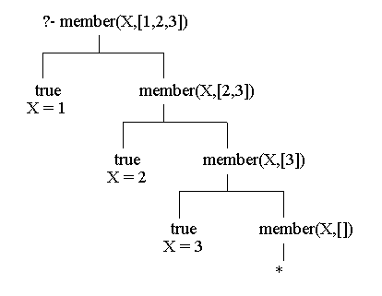
member(2,[1,2,3]).
member(X,[1,2,3]).

Slide 19
member([3,Y], [[1,a],[2,m],[3,z],[4,v],[3,p]]).
member(X,[23,45,67,12,222,19,9,6]), Y is X*X, Y < 100.

Slide 20
Facts and Rules
size([],0).
size([H|T],N) :- size(T,N1), N is N1+1.
Goals
size([bill,ted,ming,pascal,nat,ron],N).
size([a, [b, c, d], e, [f | g], h], N).

Slide 21
Try it.
takeout(X,[X|R],R).
takeout(X,[F|R],[F|S]) :- takeout(X,R,S).
When X is taken out of [X|R], R results.
When X is taken out of the tail of [X|R], [X|S] results,
where S is the result of taking X out of R.
takeout(X,[1,2,3],L).

Slide 22
takeout(3,[1,2,3],[1,2])
|
|
takeout(3,[2,3],[2])
|
|
takeout(3,[3],[])
|
|
true

Slide 23
Concatenation
If the first argument is the empty list then the second and the third arguments must be the same list (call it L); this is expressed by the following Prolog fact:
conc([],L,L).
If the first argument of conc is non-empty list then it has a head and tail and must look like this:
[X|L1]
23

Slide 24
conc(L1, L2, L3) if L3 is the concatenation of L1 and L2.
conc([], L, L).
conc([X|L1], L2, [X|L3]) :- conc(L1, L2, L3).

Slide 25
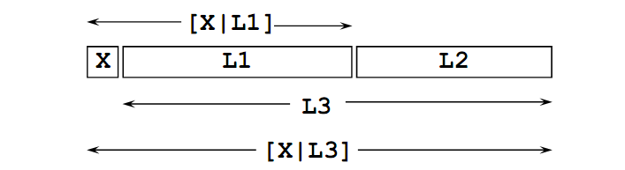

Slide 26
Examples
?- conc( [a,b,c], [1,2,3], L).
L = [a,b,c,1,2,3]
?- conc( L1, L2, [a,b,c] ).
L1 = []
L2 = [a,b,c];
L1 = [a]
L2 = [b,c];
L1 = [a,b]
L2 = [c];
L2 = [c];
L1 = [a,b,c]
L2 = [];
false.

